Slide 1
Introduction to HTML

Slide 2
HTML Text Formatting

Slide 3
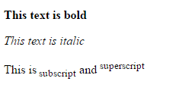
Text Formatting

Slide 4
HTML Formatting Elements
Formatting elements were designed to display special types of text:
<b> - Bold text
<strong> - Important text
<i> - Italic text
<mark> - Marked text
<small> - Small text
<del> - Deleted text
<ins> - Inserted text
<sub> - Subscript text
<sup> - Superscript text

Slide 5
HTML <small>, <mark>, <del>, <ins>, <sub> and <sup> Elements
The HTML <small> element defines smaller text
The HTML <mark> element defines marked or highlighted text
The HTML <del> element defines deleted (removed) text. The HTML <ins> element defines inserted (added) text.
The HTML <sub> element defines subscripted text.
The HTML <sup> element defines superscripted text.

Slide 6
Formatted Text
<p>
Here is a paragraph with <em>emphasized</em> text and <strong>important</strong> text.
</p>
<p>
Here is another paragraph with <i>Italic</i> text and <b>Bold</b> text.
</p>
Here is a paragraph with Emphasized text and Important
text.
Here is another paragraph with Italic text and Bold text.

Slide 7
Formatted Text
<p>Here is a <mark>highlighted</mark> text and this is <small>smaller</small> text.</p>
Here is a text and this is smaller text.
Highlighted
<p>Here is <del>some deleted</del> text and this is <ins>some inserted</ins> text.</p>
Here is some deleted text and this is some inserted text.
<p>This is <sup>superscripted</sup> text and this is <sub>subscripted</sub> text.</p>
Here is ^{superscripted} text and this is _{subscripted} text.

Slide 8
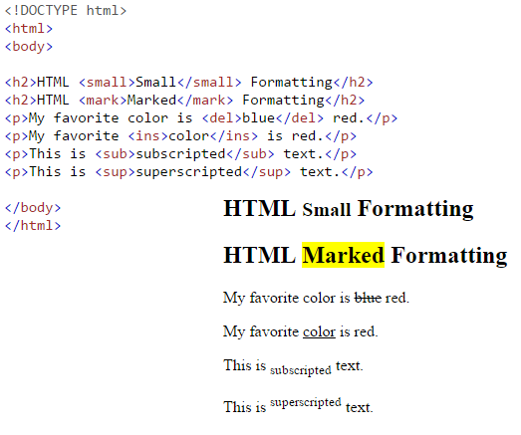
HTML <small>, <mark>, <del>, <ins>, <sub> and <sup> Elements
EXAMPLE

Slide 9
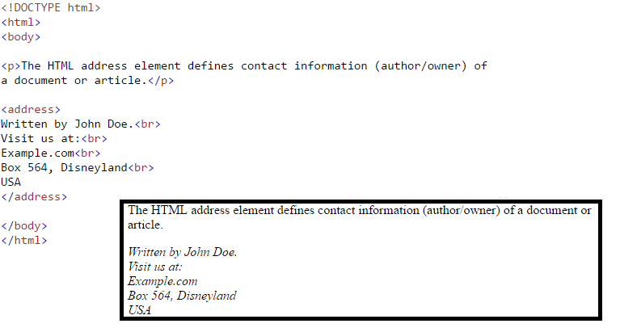
HTML <address> for Contact Information
The HTML <address> element defines contact information (author/owner) of a document or an article.
The <address> element is usually displayed in italic. Most browsers will add a line break before and after the element.

Slide 10
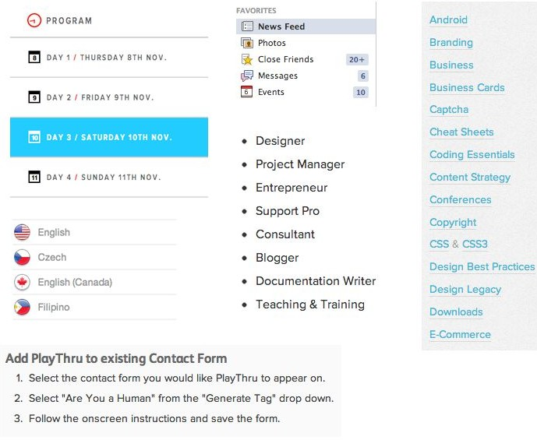
Lists
Lists are used everywhere and can be customized to look as you want

Slide 11
Lists
Unordered list (bullets)
<ul>
<li>List Item</li>
<li>Another List Item</li>
</ul>
List Item
Another List Item
Ordered list (sequence)
<ol>
<li>List Item</li>
<li>Another List Item</li>
</ol>
List Item
Another List Item

Slide 12
HTML Lists
For Unordered HTML List we can change List Item Marker
The CSS list-style-type property is used to define the style of the list item marker
<ul style="list-style-type:disc">
<li>List Item</li>
<li>Another List Item</li>
</ul>
List Item
Another List Item
possible values for list-style-type property are: disc, circle, square, none

Slide 13
More on HTML Lists
For ordered HTML List we can change the Type of the List Marker
The CSS type property is used to define the type of the ordered list item marker
List Item
Another List Item
<ol type="A">
<li>List Item</li>
<li>Another List Item</li>
</ol>
type="1" | The list items will be numbered with numbers (default)
type="A" | The list items will be numbered with uppercase letters
type="a" | The list items will be numbered with lowercase letters
type="I" | The list items will be numbered with uppercase roman numbers
type="i" | The list items will be numbered with lowercase roman numbers

Slide 14
Try remaining type attribute options like upper case lower case numbers upper roman numbers

Slide 15
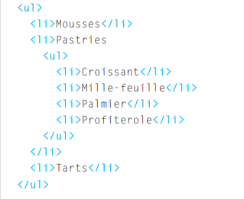
Nested lists

Slide 16
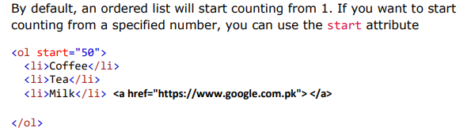

Control list counting

Slide 17
More on HTML Lists
HTML also supports description lists which is a list of terms, with a description of each term.
The <dl> tag defines the description list, the <dt> tag defines the term (name), and the <dd> tag describes each term
coffee
black hot drink
milk
white cold drink
<dl>
<dt>coffee</dt>
<dd>black hot drink</dd>
<dt>milk</dt>
<dd>white cold drink</dd>
</dl>

